Slide 1


The Importance of Sleep

Slide 2

"And He it is Who has made the night a covering for you, and Who has made sleep for rest, and has made the day for rising up.”
(Holy Quran 25:48)
Allah has made the night for us to sleep:
“Verily, We have created everything in due measure.”
(Holy Quran 54:50)
→ This means that everything has an appointed time and place

Slide 3

According to these verses (25:48 & 54:50 ), we are supposed to follow the natural sleep cycle created by Allah. Scientists call it the CIRCADIAN RHYTHM.
The Circadian Rhythm is our body’s internal biological clock that helps us know when to feel sleepy at night and when to be awake during the day to eat, play etc.
The circadian rhythm works on a 24-hour cycle.
Light is a big signal for this clock, which is why our body
makes a sleep-related hormone called melatonin in the dark,
and this is also why it's harder to sleep when it's bright.

Slide 4
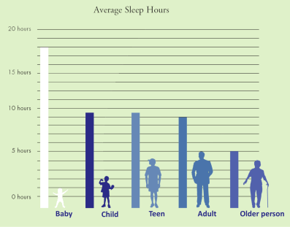
How Much Sleep Do Humans Need?
In general, nowadays, people are getting less sleep than they actually need.

Slide 5

Why Are We Not Getting Enough
Sleep Nowadays?
Before the invention of artificial lighting, the sun was the major source of lighting; people spent their evenings in (relative) darkness and their sleep would be in rhythm with nature.
But now, many people have created their own schedule which disrupts the human’s natural sleep cycle.
Some people don’t have a choice because they have longer work
hours and night shifts.

Slide 6

But the PROBLEM is the availability of round-the-clock entertainment on our devices
Electronic devices (television, computers, smartphones)
have become permanent features of our everyday life
blue light emitted by electronic devices suppresses the secretion of the hormone melatonin, which is supposed
to regulate our sleep
So with the increased use of electronic devices,
there is a decrease in sleep quality

Slide 7
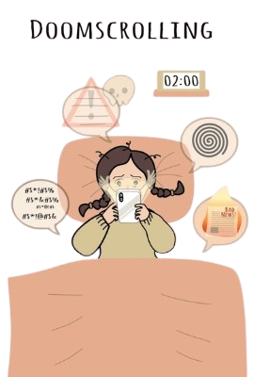
Put away your devices at least 2-3 hours before bedtime!

Slide 8

Why Is Sleep Important?
Getting enough quality sleep at the right times, is as essential for our survival as food and water!
Sleep affects almost every type of tissue and system in the body (brain, heart, lungs, metabolism, immune function, mood, disease resistance etc.)
chronic lack of sleep, or getting poor quality sleep, increases the risk of health problems (high blood pressure, cardiovascular disease, diabetes, depression, and obesity)
Sleep deprivation in children appears to set up behavior problems later in life

Slide 9
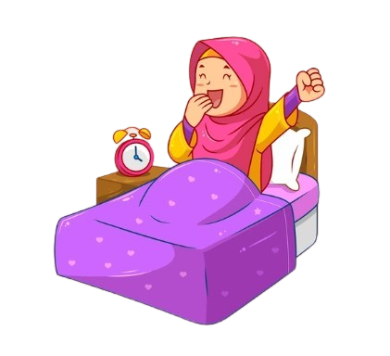
Tips to Get Good Quality Sleep
Maintain the same bedtime and wake time every day
Use your bed only for sleeping and avoid other activities in bed, so your brain associates your bed with sleep
Your bedroom should be cool, quiet, dark and comfortable
Follow a predictable routine before bedtime (brushing teeth, taking bath/shower, putting on pajamas, reading a story, offering prayers…)
Keep all sorts of screens out of your bedroom and stop their use at least a couple of hours before bedtime
To relax, take 3 deep and slow breaths and think of positive images like being in your favorite place (for example on a beach)
Exercising earlier in the day can help with falling asleep and staying asleep later that evening
Avoid caffeinated drinks like soda starting at late afternoon, as they can cause nighttime awakenings and shallow sleep

Slide 10


Allah says in the Holy Quran:
“…remember Allah, standing and sitting, and lying on your sides.” (4:104)
This means we should also remember and pray to Allah before sleeping.

Slide 11

Hazrat Aisha^{(ra)} states:
“When the Messenger of Allah^{(sa)} would lie down every night on his bed, he would raise his hands in the supplication position and pray. He would recite Surah Ikhlas (Qulhuwallahu Ahad) 3 times, Surah Falaq (Qul A’oodhubi Rabbil Falaq) once and Surah Naas (Qul A’oodhubi Rabbinnaas) once and blow on his palms and wiping his hands over his blessed body where they could reach; this was done thrice.’

Slide 12
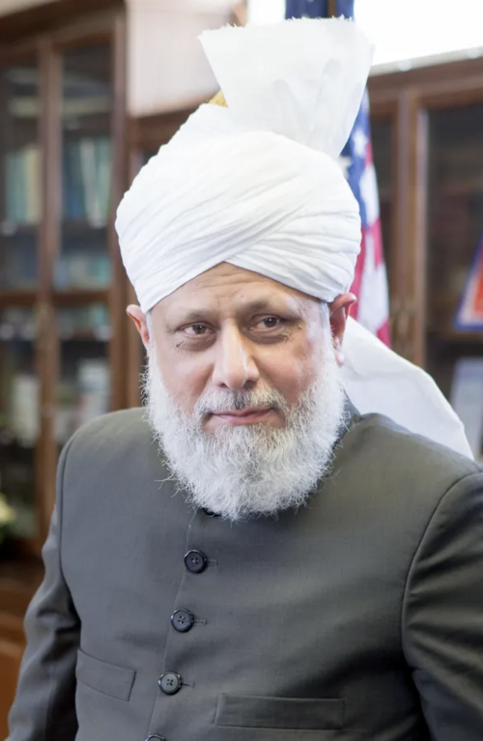
Here is some guidance from
beloved Huzoor(aba) on
how to sleep more peacefully:
https://www.youtube.com/watch?v=IlZhSXD6Z_E&t=354s

Slide 13


Fun Fact
This is how the The Holy Pophet Muhammad^{(sa)} would sleep:
He would put his blessed right hand under his blessed right cheek. He would lie on his blessed right side
facing the Qibla and rest on a pillow that
was made from leaves of a date tree.

Slide 14
Resources:
https://alislam.org/quran/app/1?options=sc
https://www.ninds.nih.gov/health-information/public-education/brain-basics/brain-basics-understanding-sleep
https://pmc.ncbi.nlm.nih.gov/articles/PMC9424753/
https://www.health.harvard.edu/staying-healthy/blue-light-has-a-dark-side
https://www.sleepfoundation.org/bedroom-environment/blue-light
https://www.azafap.org/sleep-big-and-small-sleep-101/?msclkid=381fe07718141e52923c894f413277f2&utm_source=bing&utm_medium=cpc&utm_campaign=AZAFAP%20-%20Blog%20%28US%29&utm_term=effects%20of%20sleep%20deprivation&utm_content=Effects%20Of%20Sleep%20Deprivation
https://www.alislam.org/articles/remembrance-of-allah-lying-on-your-sides/
https://www.youtube.com/watch?v=IlZhSXD6Z_E&t=440s

